Slide 1

CYBER DOJO
Dhivya A
Corporate Trainer
GLOBAL SOFTWARE SERVICES
KGiSL

Slide 2

C Program
Output:
For 2, prints EVEN
For 18, prints EVEN
For 21, prints ODD
For 1, prints ODD
For 0, ??????
For -4, -7….. ?????
For 5.8, 3.9…..???????
main()
{
int val;
printf(“Enter the value:”);
scanf(“%d”,&val);
if((val%2) == 0)
printf(“EVEN”);
else
printf(“ODD”);
}

Slide 3
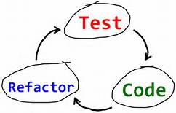
Test Driven
You need an evolutionary approach to development which combines test-first development where you write a test before you write just enough production code to fulfill that test and refactoring.

Slide 4


Slide 5
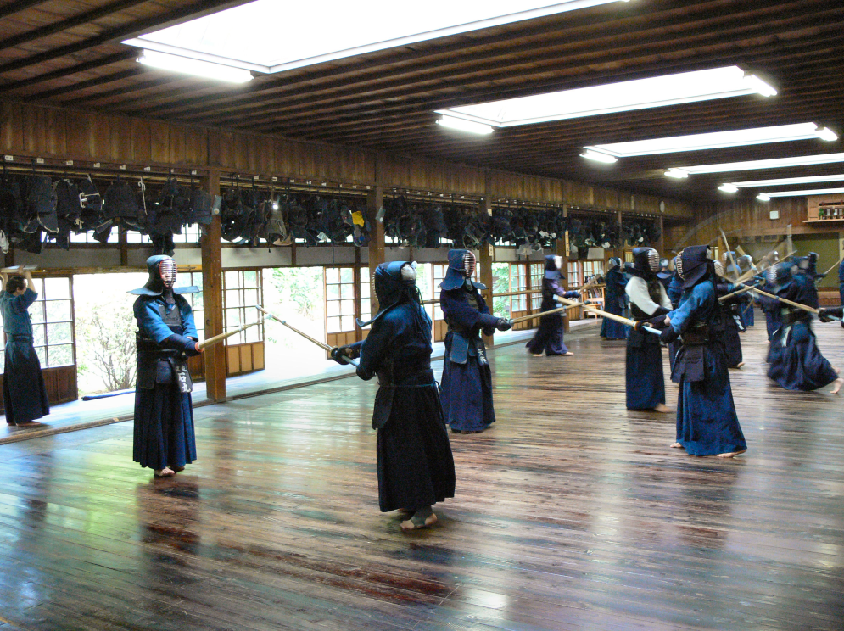
DOJO
A dojo is a place where martial artists practice martial arts.

Slide 6
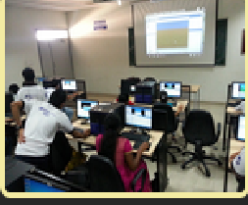
CYBER DOJO
Cyber-dojo is where programmers practice programming!

Slide 7
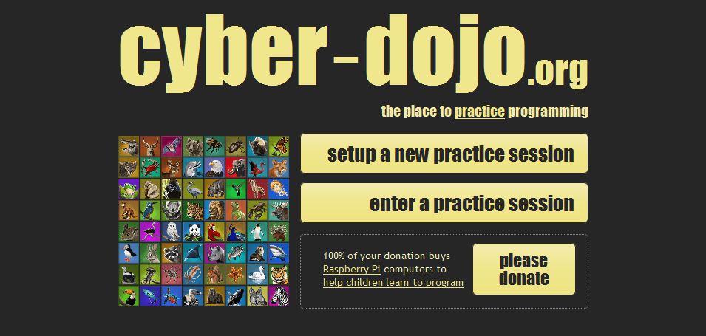
How do I start? - http://www.cyber-dojo.org/

Slide 8
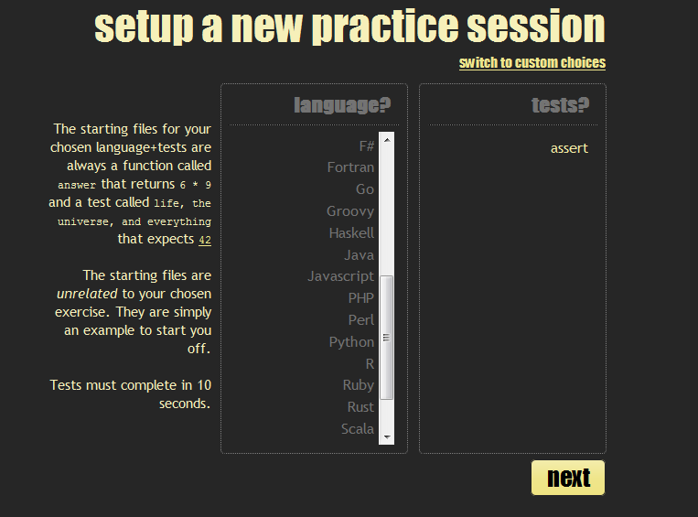

Slide 9
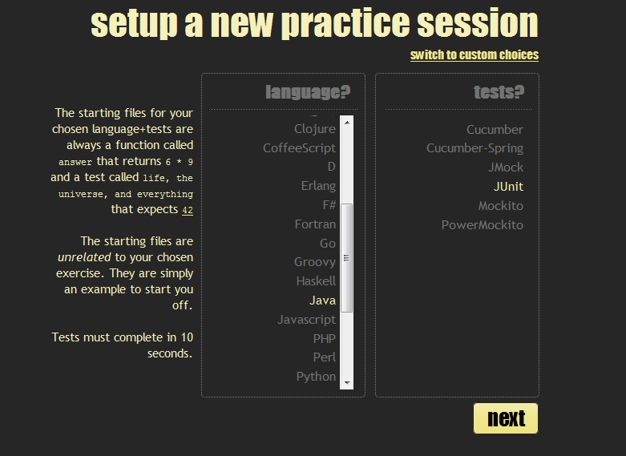

Slide 10
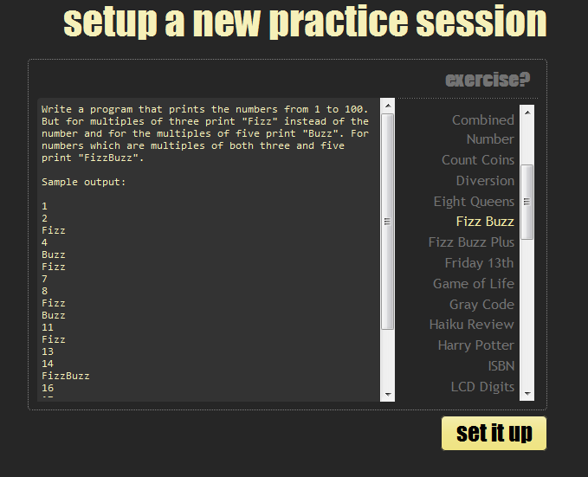

Slide 11
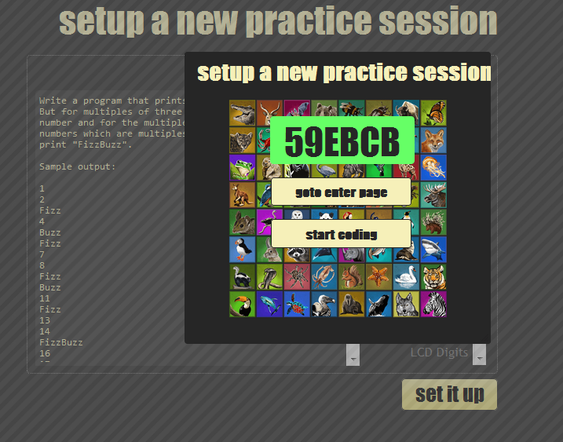

Slide 12
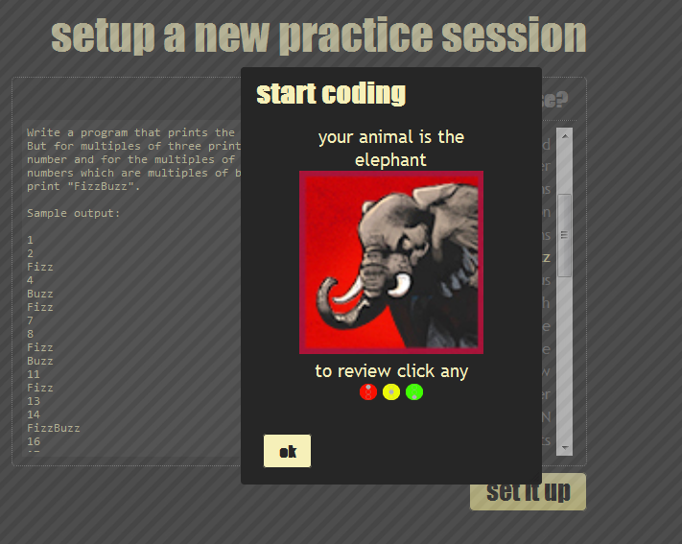

Slide 13
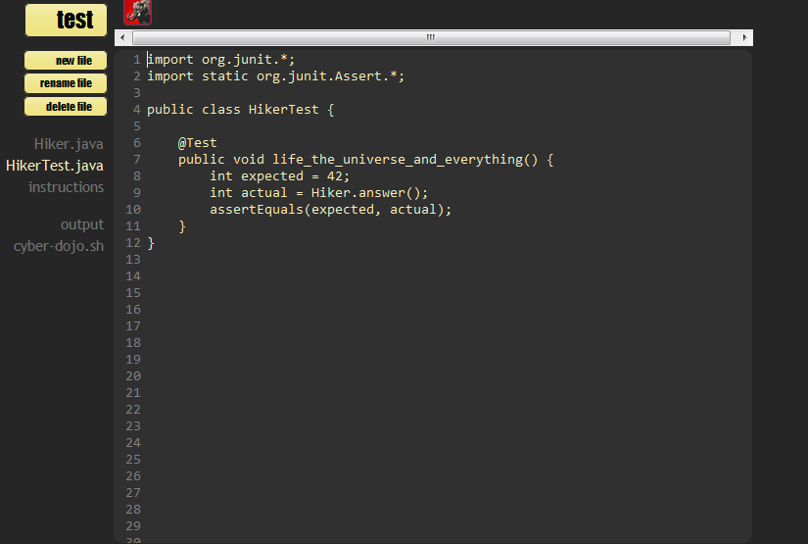

Slide 14
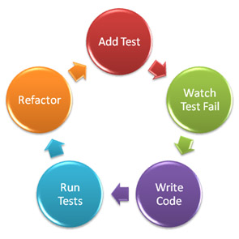

Slide 15
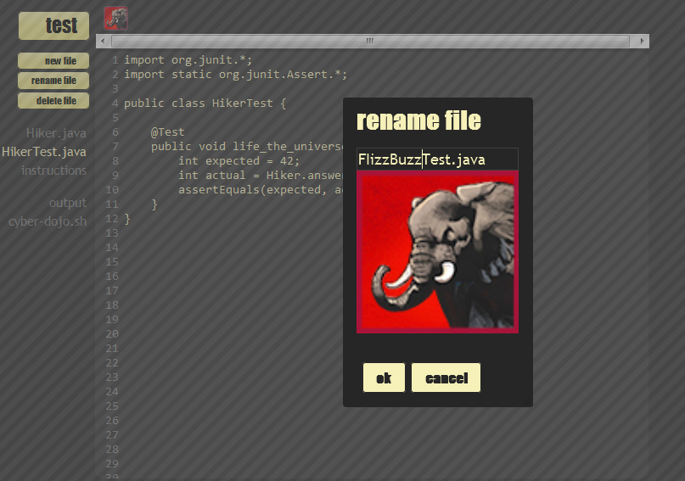
RENAME FILES

Slide 16
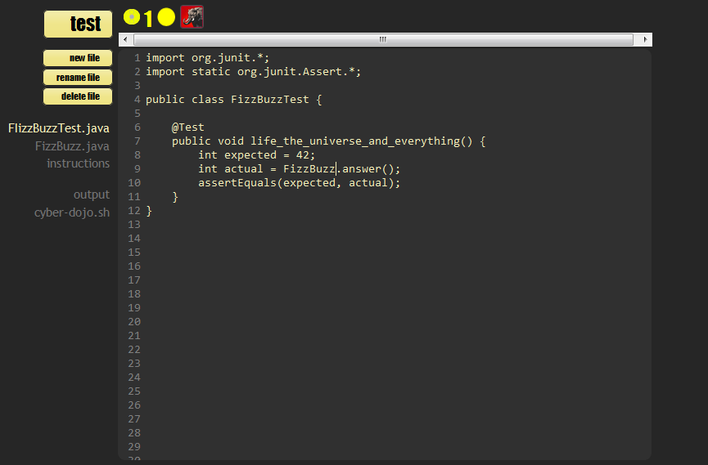
CHANGE CLASS and TEST CASE NAMES

Slide 17
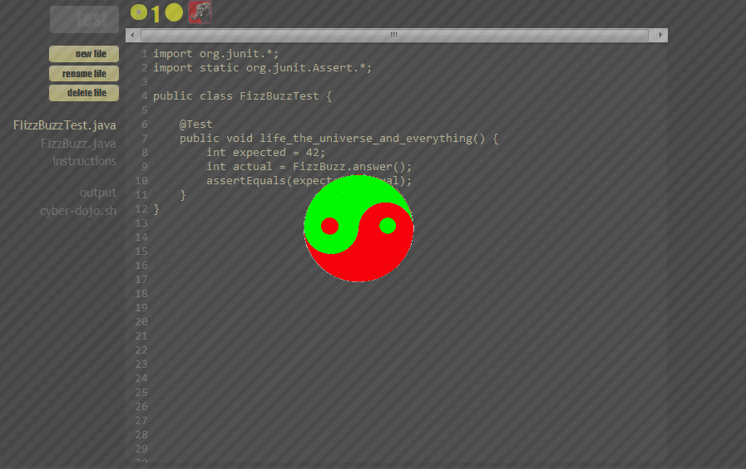
RUN TEST

Slide 18
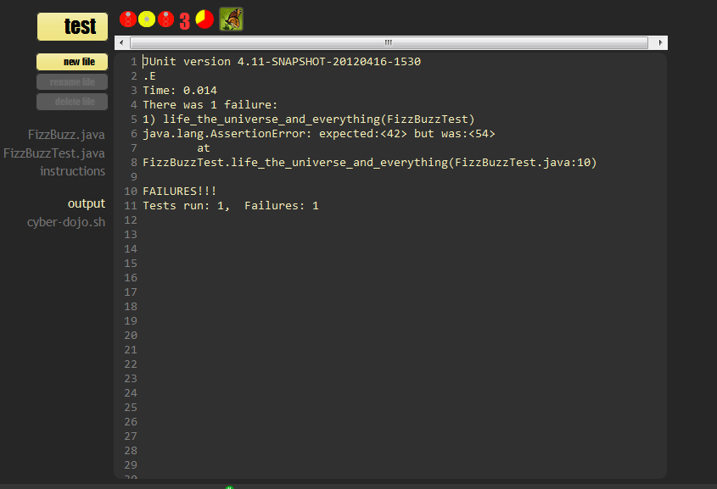
TEST FAILS

Slide 19
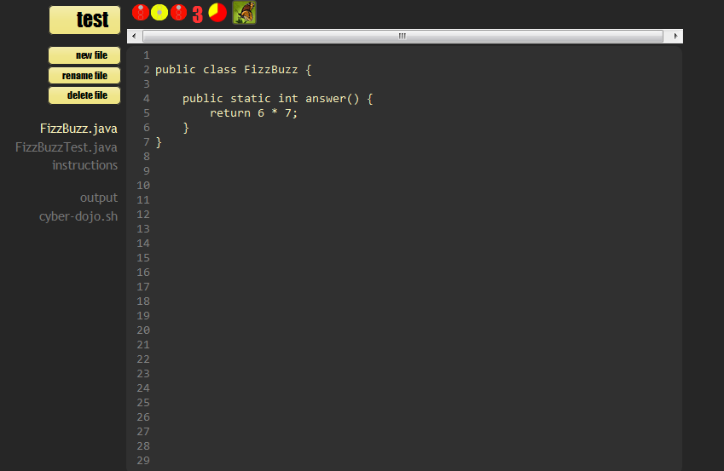
WRITE CODE

Slide 20
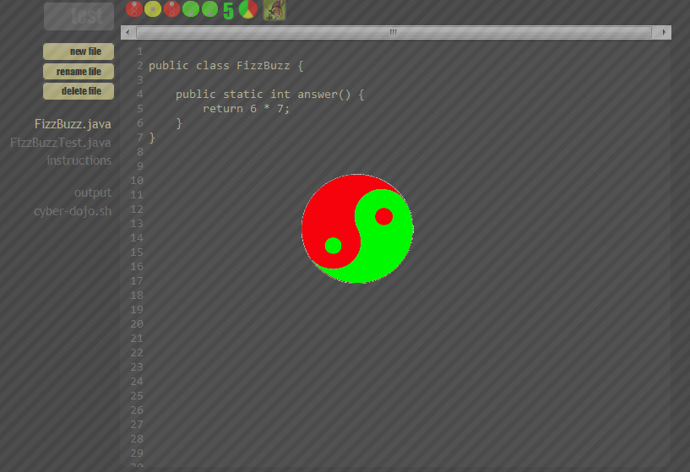
RUN TEST

Slide 21
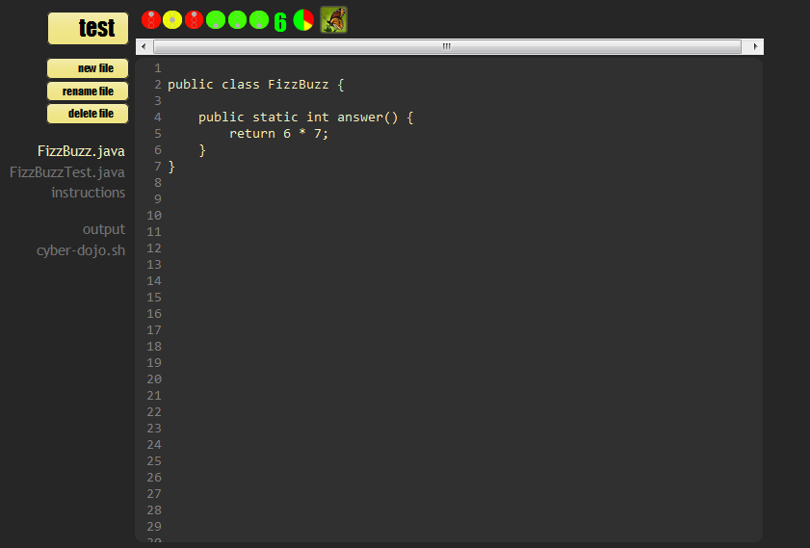
REFACTOR

Slide 22

Cyber-dojo is not an individual development environment.
Cyber-dojo is a shared learning environment.
In a cyber-dojo you focus on improving rather than finishing.
In a cyber-dojo you practice by going slower.

Slide 23
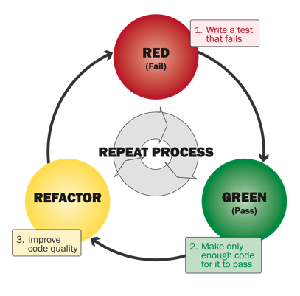
SIGNALS & COLORS

Slide 24
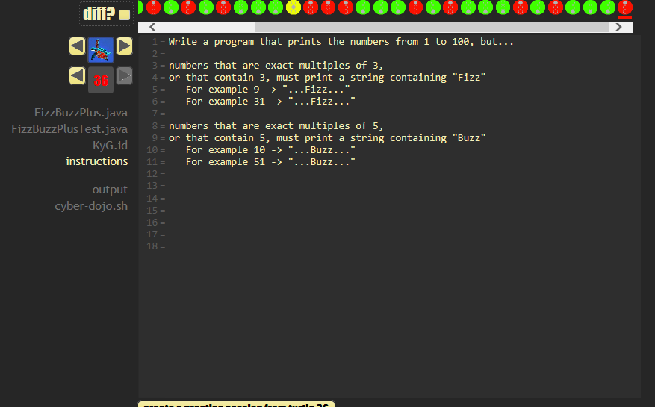
FIZZBUZZPLUS

Slide 25
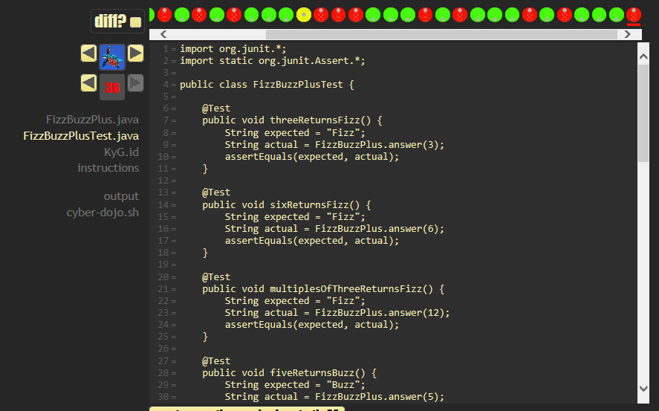
FIZZBUZZPLUSTEST.JAVA

Slide 26
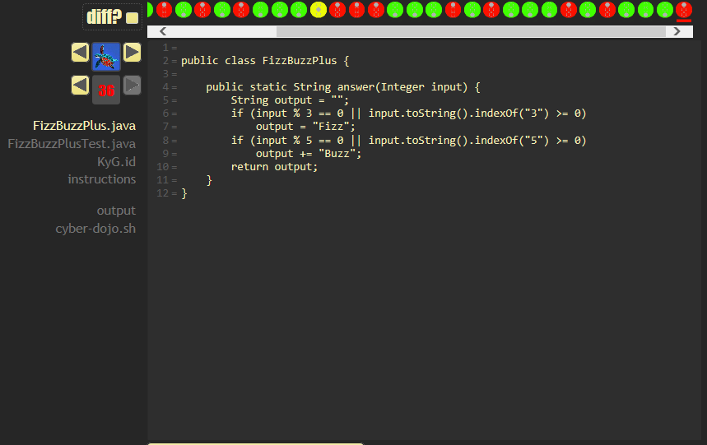
FIZZBUZZPLUS.JAVA

Slide 27
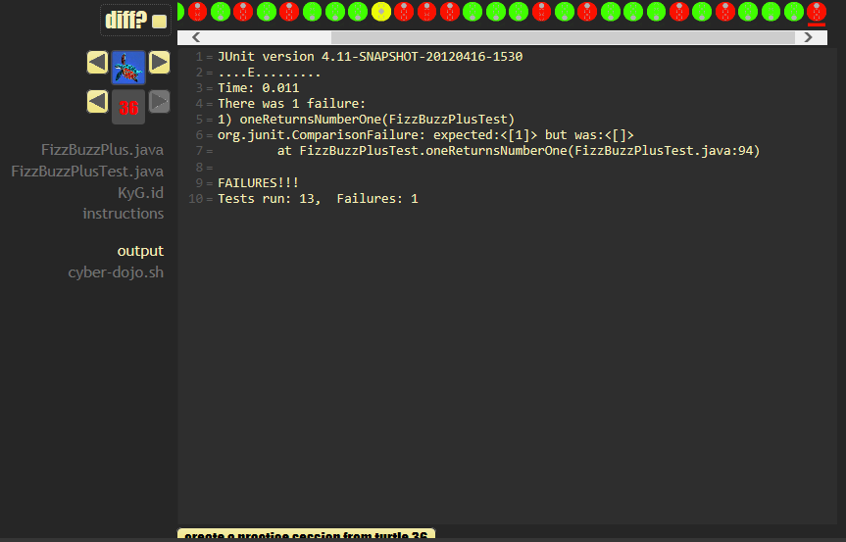
OUTPUT

